Slide 1
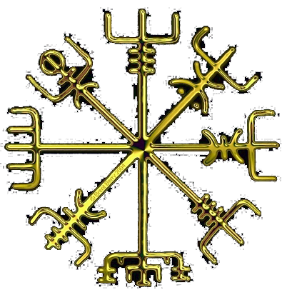
TMF 2011 17
VIKINGOVIA D. Nagaj, RCQI IoP SAS
amulet Vegvisír, Brent Berry

Slide 2
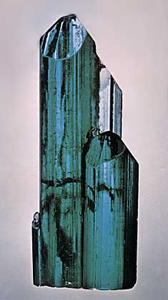
Legendy alebo fyzika?
According to a legend, Vikings were able to navigate in an ocean even during overcast (dull) weather using tourmaline crystals.
Study how it is possible to navigate using a polarizing material. What is the accuracy of the method?
www.palagems.com

Slide 3
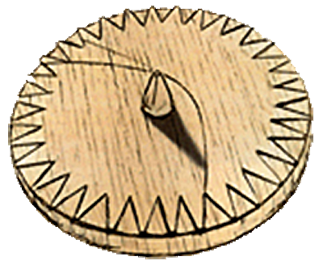
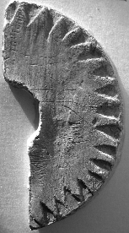
Kde je sever?
zhruba rovnaká zemep. šírka, plavba V–Z
4 týždne okolo letného slnovratu
poloha slnka + čas = sever
ako merať čas?
poloha slnka = sever
celý deň si kreslím tieň gnómonu
archeológia: málo dôkazov
[Carl V. Sølver, C. L. Vebæk, LINK]

Slide 5
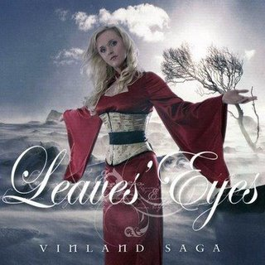
Čo vravia ságy?

Slide 6
Hrafns Saga (~1300AD)
“The weather was thick and stormy… The king looked about and saw no blue sky… Then the king took the sunstone and held it up, and then he saw where the Sun beamed from the stone.”

Slide 7
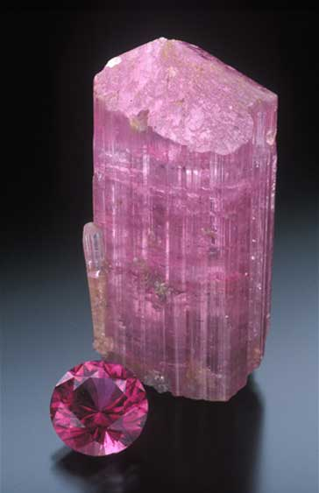
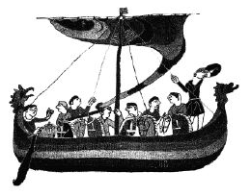
Legenda ...
slnečný kameň solarsteinn
kryštál turmalín?
Bayoux tapestry
rubellit/ružový turmalín

Slide 8
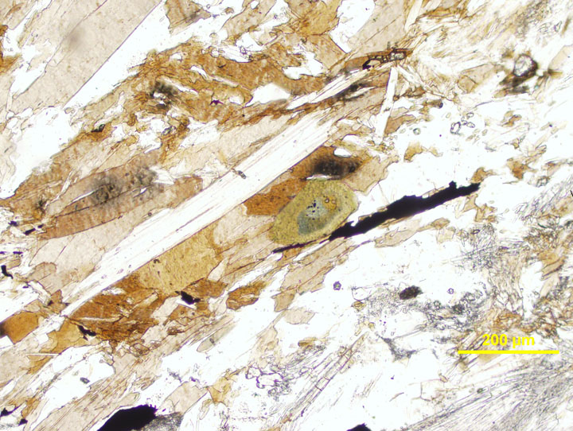
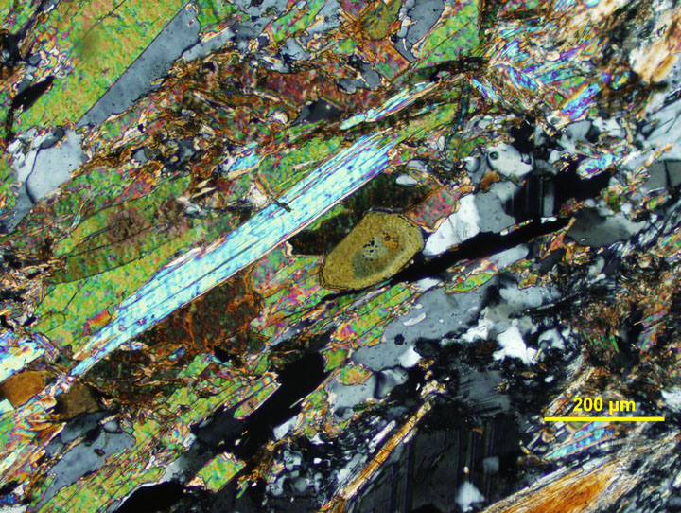
Legenda ...
slnečný kameň solarsteinn
kryštál turmalín?
[science.smith.edu, LINK]
Bayoux tapestry
science.smith.edu

Slide 9
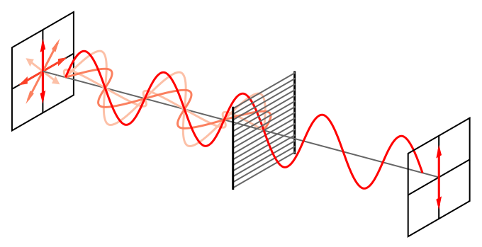
Polarizácia svetla
elmag. vlna
nepolarizované svetlo: intenzita E – všetky smery
lineárny polarizátor prepúšťa len istý smer E
wikipedia.org

Slide 10
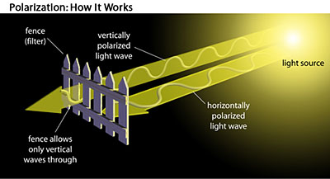
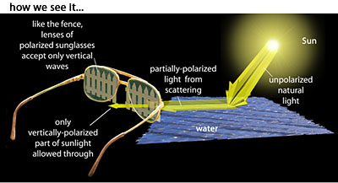
Lineárne polarizované svetlo
povrch vody
sklo, plexisklo ...
svetlo z dúhy
povrch cesty
atmosféra
miera lineárnej polarizácie? Toč filtrom!

Slide 11
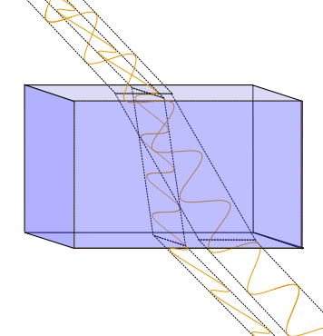
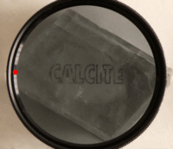
Birefringentné kryštály (kalcit, …)
rôzny index lomu pre dve rôzne polarizácie
otáčanie ... zmeny farby/svetlosti... test polarizácie
wikipedia.org

Slide 12
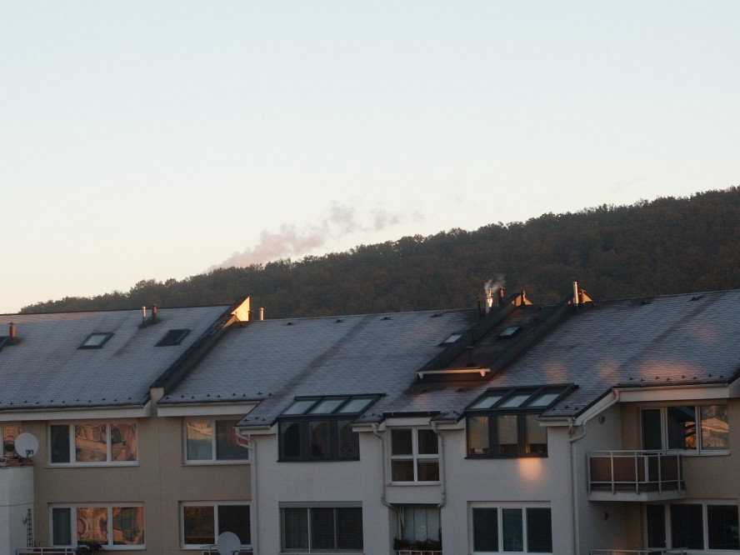
Bez filtra

Slide 13
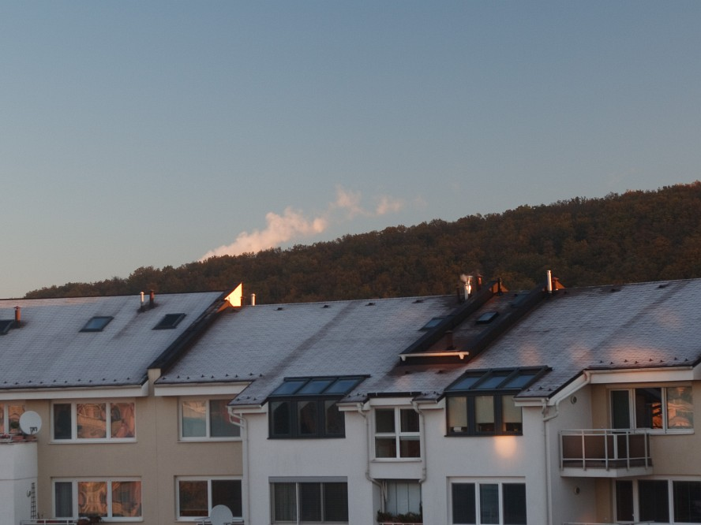
S filtrom

Slide 14
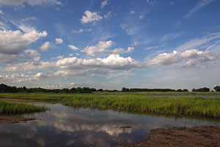
Polarizačné filtre a obloha
www.photo96.com

Slide 15
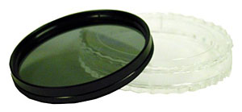
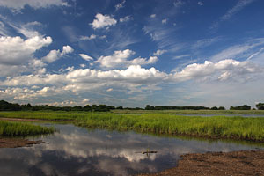
Polarizačné filtre a obloha
www.photo96.com

Slide 16
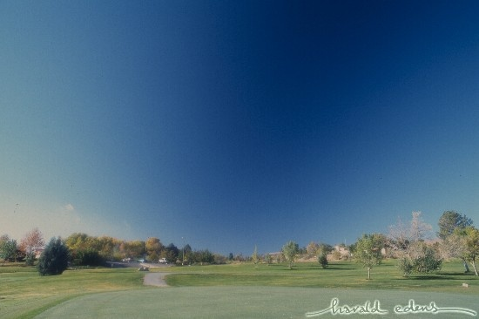
Polarizácia slnečného svetla
www.weatherscape.com

Slide 17
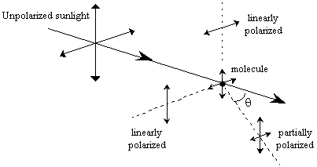
Polarizácia slnečného svetla
Rayleigh scattering
maximum polarizácie pri 90º
točím filter, hľadám zmeny

Slide 18
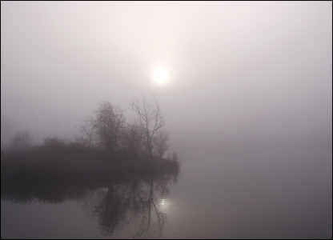
Polarizácia za hmly/pod oblakmi
rovnaké rozloženie ako za jasného dňa?
kružnica, ňou definovaná plocha kolmá na smer k slnku
ak sú mraky osvetlené zhora priamo?
nižšia miera polarizácie?
Chris Light
www.deskpicture.com

Slide 19
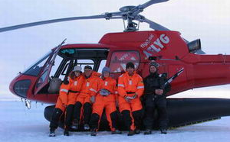
Ozajstný výskum
Gábor Horváth
Could Vikings have navigated under foggy and cloudy conditions by skylight polarization? …
Hegedüs et al., Proc. R. Soc. A 2007 463, 1081-1095 [LINK]

Slide 20
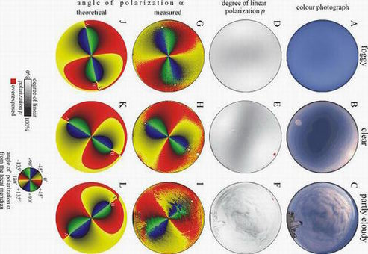
Gábor Horváth, physorg.com [LINK]

Slide 21
Mnoho textu
“Using full-sky imaging polarimetry, we have shown that one of the two atmospheric optical prerequisites of the polarimetric Viking na-vigation is always fulfilled under both foggy and cloudy conditions. The distribution of the direction of polarization of skylight on the foggy or cloudy celestial hemisphere is similar to that of the clear sky, which was a great surprise for us. However, we would like to emphasize that the Dutch meteorologist Guenther P. Koennen has already hypothesized this phenomenon in his famous book Polarized Light in Nature (Cambridge University Press, 1985).
If the fog layer is illuminated by direct sunlight, the other prerequi-site is usually satisfied only for cloudy skies. In sunlit fog, the Vikings could have navigated by polarization, only if the polarization of light from the foggy sky was sufficiently strong.”
interview with Gábor Horváth, physorg.com [LINK]

Slide 22
Mnoho textu: Dva výsledky
“Using full-sky imaging polarimetry, we have shown that one of the two atmospheric optical prerequisites of the polarimetric Viking na-vigation is always fulfilled under both foggy and cloudy conditions. The distribution of the direction of polarization of skylight on the foggy or cloudy celestial hemisphere is similar to that of the clear sky, which was a great surprise for us. However, we would like to emphasize that the Dutch meteorologist Guenther P. Koennen has already hypothesized this phenomenon in his famous book Polarized Light in Nature (Cambridge University Press, 1985).
If the fog layer is illuminated by direct sunlight, the other prerequi-site is usually satisfied only for cloudy skies. In sunlit fog, the Vikings could have navigated by polarization, only if the polarization of light from the foggy sky was sufficiently strong.”
interview with Gábor Horváth, physorg.com

Slide 23
Poďme merať!
jasná obloha, stupeň polarizácie: nájsť tú 90º kružnicu
širokouhlý objektív/fish eye, statív, manuálne nastavenia
hmla, zamračené... polarizácia? smer k slnku? presnosť?
Chris Light
www.deskpicture.com

Slide 24
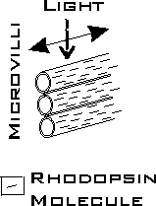
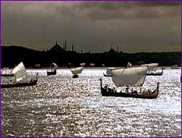
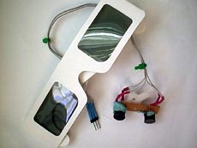
Zaujímavosti
Hmyz a polarizácia [LINK]
Pokus navigovať robota [LINK]
Vikingská navigácia [LINK]
www.polarization.com
www.pbs.org
www.seattlerobotics.com

Slide 25
Dik Browne: Hagar the Horrible

